Slide 1

Towards a VA National Learning Health System in Anesthesiology: A Summary Anesthesia Model (SAM)
A Health Solutions Management Brief for VA National Anesthesia Service
September 11, 2015
Rafael Richards MD MS, Anesthesiology and Critical Care
Physician Informaticist, Health Solutions Management
Office of Informatics and Analytics, Veterans Health Administration
Department of Veterans Affairs

Slide 2
Background: Automated anesthesia record keeping (ARK) and critical care information management systems (CIS) from multiple vendors are deployed at 129 VA hospitals to support day-to-day clinical operations and automated record keeping in the OR’s and ICU’s. Opportunity: Most of this information remains within the within the vendor’s database at the local site, or is published only in unstructured form. It is therefore not fully leveraged for national quality, access, or outcomes improvement. Inspiration: What are examples of successful national perioperative quality improvement initiatives? Challenges: What are the challenges to achieve integration for national anesthesia quality improvement in VA with our CIS/ARK systems?
VA Anesthesia and Critical Care
Information Management Systems

Slide 3
VA Anesthesia Information Systems

Slide 4
VA Anesthesia Information Management Systems
Commercially licensed vendor-supported products
VISN-centric organization, deployment, configuration, management, and maintenance
Data stored on vendor’s database in each VISN.
VA class-3, field-managed software:
Not VA developed, integrated, or maintained
Multiple, external commercial products
Products not listed on VA TRM
Not leverage VA VISTA architecture
Not nationally integrated, updated, standardized, or maintained
Notes:
Business owner is Biomedical Engineering
Stakeholders include Anesthesiologists, CRNA’s

Slide 5


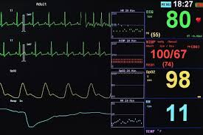
VA Anesthesia: Overview of components and data flow
(Local View)
Case summary (5-50+ pages)
Scanned and stored in VISTA Imaging
VISTA Imaging
View-only, Unstructured data
Not machine-processable
No analytics feasible.
CIS/ARK
Local / VISN reports against
Vendor Database only.
Vendor-specific reporting
Clinical observations/actions
Automated vitals capture
Data bridge
VISTA
Class-3 software
Closed / proprietary
VISN-specific
VISTA data extracts :
Demographics, Labs, Vitals,
Medications, History, etc.
Notes:
This is very feasible

Slide 6
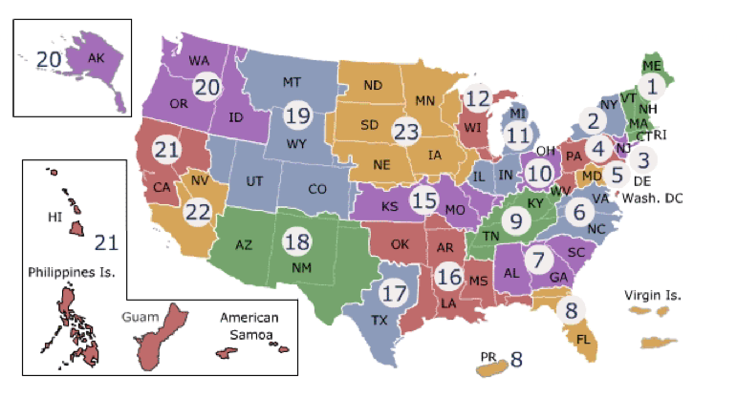
VA Anesthesia: VISN-centric deployment
(National view)

Slide 7
VA Anesthesia: Overview of components and data flow
(National view - Current)
Case summary (5-50+ pages)
Scanned and stored in VISTA Imaging
VISTA Imaging
View-only, Unstructured data
Not machine-processable
No analytics feasible.
Vendor-specific
Storage format
PDF
PDF
PDF
PDF
PDF
PDF
CIS/ARK
CIS/ARK
CIS/ARK
CIS/ARK
CIS/ARK
CIS/ARK
Local / VISN reports against
Vendor Database only.
Vendor-specific reporting
Vendor-specific
Systems
Vendor-specific
Data bridges (x6)
bridge
bridge
bridge
bridge
bridge
bridge
VISTA
Class-3 software
Closed / proprietary
Vendor-specific
VA National standard
clincal database

Slide 8
VA Anesthesia: Overview of components and data flow
(National view – Desired)
National Anesthesia Analytics
Integration of structured, coded data across all CIS/ARK systems is a pre-requisite for national analytics.
Integration
CIS/ARK
CIS/ARK
CIS/ARK
CIS/ARK
CIS/ARK
CIS/ARK
VISN-specific reports
Vendor-specific reporting
Vendor-specific
Systems
Vendor-specific
Data bridges (x6)
bridge
bridge
bridge
bridge
bridge
bridge
VISTA
VA National standard
clincal database

Slide 9
Integration Model I: VA Surgical Quality Improvement Program (VASQIP)

Slide 10
VA Surgical Quality Improvement Program (VASQIP)
Leverages existing VISTA Architecture
Class-1 VA nationally standardized architecture
OIT architecture, design, testing, standards, and support
All updates deployed nationally and synchronously via fully automated means
All VA sites use the same, standardized VISTA database
No integration required; all data is captured to the national standard from the field at all sites from the outset.
All data of VISTA Surgery is available to all 160 VISTA applications, to CPRS, and to all other components of VA’s architecture, including the VISTA Evolution platform.
Set the standard nationally outside VA as the SQIP
Over 600 hospitals outside VA have adopted the VASQIP model

Slide 11
VASQIP: Overview of components and data flow
(National view)
National Surgery Analytics
Nationally standardized and coded;
Integrates all 130 VA Surgery sites.
Provides 100% complete, fully structured, computable data.
National Surgery DB
100% data availability
VISTA Surgery x130 Sites
Fully structured, computable data.
Nationally standardized and coded
Across all 130 VA Surgical Sites.
Fully integrated with all other data and applications in VA and VISTA.
VA-national standard Class-1 application
VISTA DB
VA National Standard
Clinical Database
Class-1 VA VISTA national standard architecture.
Notes:
VISTA Surgery is only 570 defined data fields

Slide 12
VASQIP: Overview of components and data flow
(National view)
Analytics
Provides structured, computable data from VISTA Surgery package.
However, less than 20% of data in VISTA Surgery is available; only a small faction (<140 fields) are ETL’d.
CDW
< 20% data
availability
VISTA Surgery x130 Sites
Fully structured, computable data.
Nationally standardized and coded
Across all 130 VA Surgical Sites.
Fully integrated with all other data and applications in VA and VISTA.
VA-national standard Class-1 application
VISTA DB
VA National Standard
Clinical Database
Class-1 VA VISTA national standard architecture.
VISTA Surgery fields in FM file 130 is 570; CDW fields from same file is 140.
Notes:
If the only analytics provided to Anesthesia nationally is through the VISTA Surgery package, then there is no need for CIS/ARK.

Slide 13
Integration Model II: ASA Anesthesia Quality Institute (AQI)

Slide 14
ASA National Anesthesia Quality Improvement
In 2010 the American Society of Anesthesiology (ASA) launched the Anesthesia Quality Institute (AQI) and established the National Anesthesia Clinical Outcomes Registry (NACOR).
Participating practices report their practice data to NACOR, and this information can be used for quality improvement, benchmarking, and research. Reporting from NACOR and access to its analytic tools is a benefit of all ASA members.
In 2014 NACOR was designated by the Centers and Medicare & Medicare (CMS) as a Qualified Clinical Data Registry (CQCR). This designation means that practices reporting the appropriate clinical outcome data will fulfill their quality reporting requirements and thereby avoid cuts in their Medicare payments.
As of September, 2015 NACOR has aggregated and analyzed 30 million cases registered for quality assessment.

Slide 15

ASA National Anesthesia Quality Improvement

Slide 16
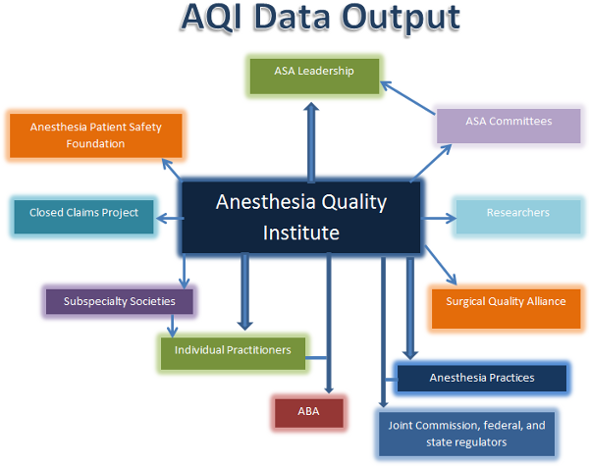
ASA National Anesthesia Quality Improvement
Notes:
https://www.aqihq.org/registry-flowcharts.aspx

Slide 17
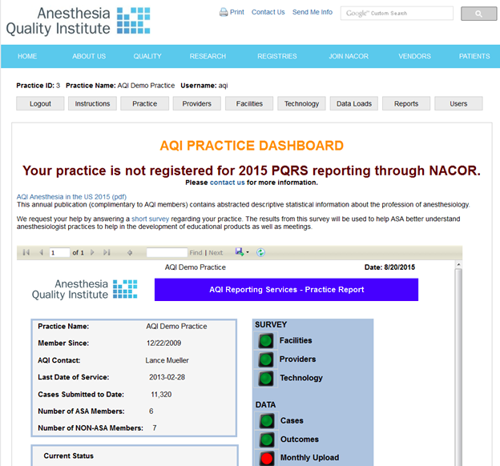
ASA National Anesthesia Quality Improvement
Notes:
https://www.aqihq.org/registry-flowcharts.aspx

Slide 18
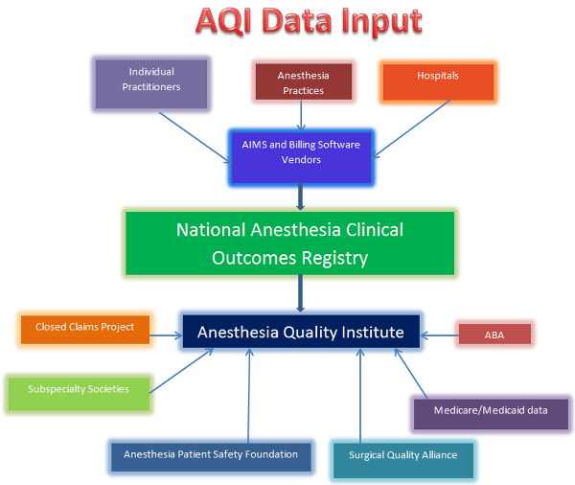
ASA National Anesthesia Quality Improvement
Informative
for SAM
Notes:
https://www.aqihq.org/registry-flowcharts.aspx

Slide 19
Integration Model III: Vendor Terminology Superset Map

Slide 20
CIS/ARK: Superset Terminology
Strategy: Create a master terminology and delegate vendors to map their systems to this terminology. The model becomes a superset accommodating all vendors’ terminology.
Implementation:
VA nursing full-time for two years created an initial terminology.
VA committee met weekly over five years to supplement the terminology. A brainstorming tool (Mindmap) was used to capture all terms.
Each vendor independently maps their own terminology to superset. Vendors do not expose or involve VA with their terminologies directly.
Vendors supplement the terminology with their own system’s terms if no mapping was available for their specific vocabulary. No inter-vendor collaboration to enforce concept convergence is required.
Status:
The terminology has grown steadily since its inception.
Terminology has grown to over 36,082 terms as of August 2015.
Notes:
Given the methodology and the very large size of the terminology, a high percentage of this is likely to map to only one vendor or no vendor.
No evidence is available to provides confirmation of any uniform mapping across vendors for any given term (i.e. that this is a valid cross-vendor map).

Slide 21
CIS/ARK: Superset Terminology
Domain | Vocabulary | # Terms
IntraOp Care | ARK 1.7 | 6753
PostOp Care | PACU v1.7 | 8958
Critical Care | ICU v1.7 | 20371
TOTAL |  | 36,082
Notes:
## VA OR and ICU Terminologies
* Vocabulary is contained in three spreadsheets labeled IntraOp (ARK), PostOp, CritCare (CIS)
* Review date: 2015-08-31
Setting |Vocab | Count
----|---- | ----
IntraOp | ARK v1.7 | 6753
PostOp | PACU v1.7 | 8958
CritCare | ICU v1.7 | 20371
TOTAL | -- | 36,082
Periop | ARK / PACU | 15711
In each spreadsheet there is a tab for many subcategories. In each tab there are additional columns (one for each of the CIS/ARK vendors) with unique IDs for each term, for each vendor (vendor-specific ID for each term).

Slide 22
Current ARK Summary
Of the total 6753 terms defined for ARK, 5901 are for anesthesia technique.
Of these, most of them define procedures such as line placement. However some terms remain under- or un-defined.
Definition | Examples of terms (# definitions) | Effect on mapping | Effect on information content
Over-definition | Peripheral IV (880) Arterial line (617) | One-to-many (unpredictable and variable) | Redundant, unnecessary information
Under-definition | EKG: (1) | Many-to-one | Loss of all meaning and context
No definition | Vitals (0) Medications (0) | Many-to-none (no mapping) | No information carrying capacity. Complete loss of data.
To be useful, a terminology should have clear, well defined, unambiguous, one-to-one mapping between terms for all stakeholders of the terminology.
Notes:
Given the methodology and the very large size of the terminology, a high percentage of this is likely to map to only one vendor or no vendor.
No evidence is available to provides confirmation of any uniform mapping across vendors for any given term (i.e. that this is a valid cross-vendor map).
Given this is an ARK record, with a focus on vitals and medications administered, there is no means for the model to accommodate this information.
ANESTHESIA CARE 6759
Anes Delivery 6470
ANESTHSIA DELIVERY 6470
AnesTechnique 5901
ANESTHESIA TECHNIQUE
Maintenance 3263
Regional 1948
MAINTENANCE
Positioning 188
Procedure 2797
Specialty Cases 279
PROCEDURE
Over-defined:
Arterial Line (x4) 617 DC'd, Insert, Observe why multiples
CVL (x3) 538 DC'd, Insert, Observe why multiples
Chest Tube (x2) 143 applies to CT cases only
PIV (x6) 880 DELIVERYC'd, Insert, Observe why multiples
Under-defined:
EKG-12 lead 1
GI Insertion 62 OGT, NGT
Anesthesia Resuscitation 39

Slide 23
Integration Model IV: Summary Anesthesia Model (SAM)
Also known as simple, small, subset,
summary-oriented (S4) metadata model

Slide 24
VA Anesthesia: National view (As-Is)
How do we leverage the VA Enterprise Architecture to
to enable anesthesia record use for national reporting?
? Integration ?
National Reports
Currently, all national ARK data is stored in unstructured form in VISTA (PDF).
VISTA Imaging
Integration of structured, data across all CIS/ARK systems is a pre-requisite for national reporting.
PDF
PDF
PDF
PDF
PDF
PDF
ark
ark
ark
ark
ark
ark
Vendor Reports
Currently only reports against Vendor-specific databases is possible. There is no cross-vendor reporting.
VISTA
Vendor-specific systems
Proprietary, non-VA
Class-3 software
Notes:
Currently all ARK records are stored in unstructured form as PDF files in VISTA Imaging

Slide 25
Summary Anesthesia Model (SAM): Objectives
Objectives of SAM:
To maximize efficient information transfer between providers in the anesthesia and critical care care setting (comprised of high volumes of time varying machine-generated data ) this will be outcomes- and summary-focused, rather than procedural details.
A concise model will allow metadata about the ARK records to be concisely summarized and exchanged and integrated based on summative metadata.
This will improve the succinctness and "signal to noise" ratio that is prevalent in critical care using a human "first pass filter" to provide the annotation and metadata immediately after the end of the case.

Slide 26
Summary Anesthesia Model (SAM): Attributes
Attributes of SAM:
Small (no redundancy; maximum size limit)
Simple (easy to map)
Summative (trends, vitals, significant events capture)
Standards-focused (linked to LOINC, SNOMED, RxNORM)
Interoperability-focused (VA-DoD, VA-AQI, VA-private sector)
Lightweight (easy to implement)
Modern (web-centric, web-standard technology)
High-quality (continuous peer-review)
Practice-driven (informed by operational systems, AQI, etc.)
Literature-linked (literature must support use of terms)
Open-licensed (for universal distribution and use)
Notes:
OBJECTIVE
anesthesia information model focused on pragmatism and simplicity to facilitate the adoption and use by the broadest base of anesthesiologists.
This model must be easy to map, implement, and maintain for all existing systems.
Therefore, it must be small and easily understood, while providing sufficient content for secondary use.

Slide 27
Summary Anesthesia Model (SAM): Attributes
Applications of SAM:
Beyond providing exchangeability of ARK charts between VA sites, and between VA-DoD, this will provide care improvements to veterans:
High reliability clinical handoffs for the (PACU, ICU, floor) teams for transitions of care on the day of surgery
Consistent follow-up care information for any special post-op care days in the days to weeks after the procedure
Advisory for anesthesiologists taking care of the patient months to years after the procedure to assure patient safety
Outcomes research enabler for all time in the future, as this will contain key metadata for cohort selection allowing risk-adjusted comparison of anesthesia techniques intraop with the patients outcomes months to years later.
Notes:
OBJECTIVE
anesthesia information model focused on pragmatism and simplicity to facilitate the adoption and use by the broadest base of anesthesiologists.
This model must be easy to map, implement, and maintain for all existing systems.
Therefore, it must be small and easily understood, while providing sufficient content for secondary use.

Slide 28
Summary Anesthesia Model (SAM): Application
A summary anesthesia model (SAM) applied to ARK reports within the VISTA architecture allows enterprise-wide query to support national anesthesia reporting.
SAM provides the structured data required to query, retrieve, index, and index ARK records nationally in the VA VISTA architecture.
SAM
VA National Reports
VISTA
PDF
PDF
PDF
PDF
PDF
PDF
ark
ark
ark
ark
ark
ark
VISTA
Class-3 software
Closed / proprietary
Vendor-specific
Notes:
Currently all ARK records are stored in unstructured form as PDF files in VISTA Imaging

